Slide 1
Airbnb New User Bookings
Predicting User Destinations from the Airbnb Dataset

Slide 2
The problem
Company
Goals
Problem statement
Airbnb is an online marketplace and hospitality service that enables people to lease or rent short-term lodging including vacation rentals, apartments, homestays, hostels, or hotel rooms,
Share more personalized content with community
Decrease the average time of booking
Better forecast demand
Given data on the user and their sessions, predict which country the user will book his/her first Airbnb in.

Slide 3
Data Wrangling
The data provided to us by Airbnb was already relatively clean and required very little wrangling.
The missing values of seconds elapsed in the sessions dataset was interpolated using Pandas.
People with ages > 125 were given an age of ‘Unknown’.
All missing and unknown values were initially converted to NaN to give it more semantic meaning.

Slide 4
Inferential Statistics
The Chi Square Test for Independence and the Two Sample Significance Test were used to gain more insight of the data via inferential statistics. The following results were obtained:
There is a gender based preference for countries. In other words, the gender of a person influences the destination of choice.
There is no relationship between the device used and the method of signup. The two quantities were found to be independent of each other.

Slide 5
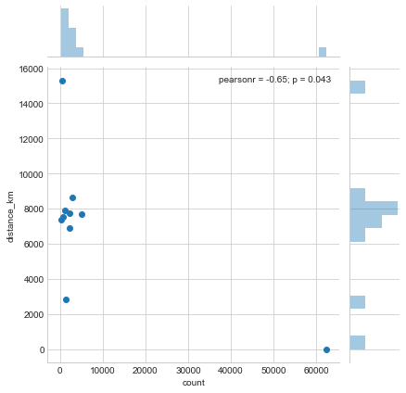
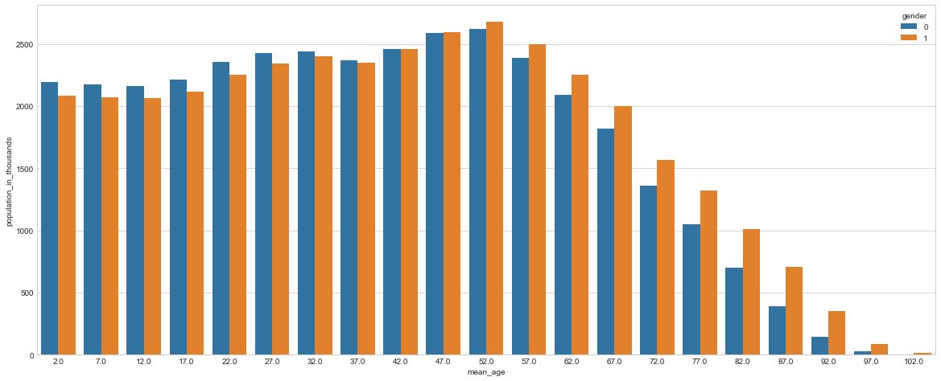
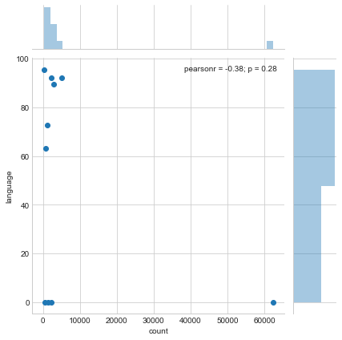
Data Visualization and Analysis

Slide 6
Country Statistics
The countries that are represented in this dataset largely consist of an aging population. The largest groups are people with mean ages 47 years and 52 years.
One very interesting thing to note is that the sex ratio is skewed towards men for younger age groups but as the mean age increases, the ratio skews more towards women. Women indeed live longer than men.
There is a negative correlation between country preference and country distance.
The correlation is more complicated for language levenshtein distance (Negative including US but positive excluding it).

Slide 7
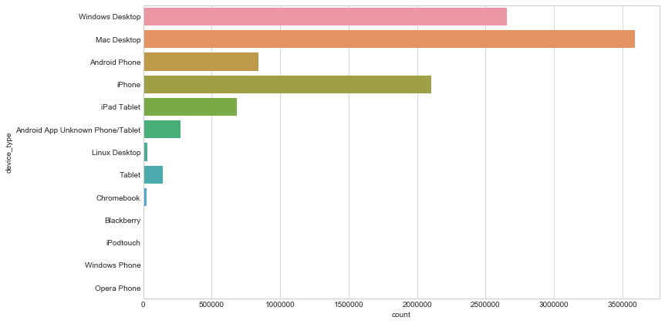
Device Usage during Sessions

Slide 8
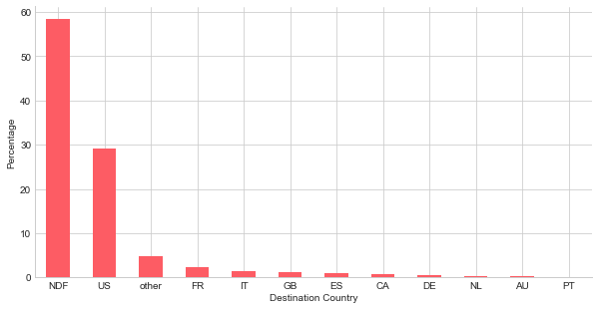
Destination Popularities

Slide 9
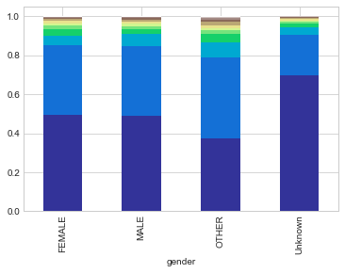
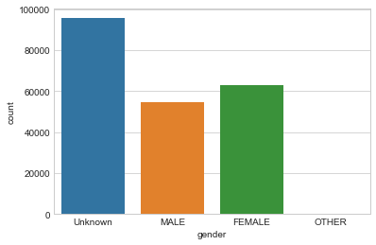
Gender

Slide 10
Gender Insights
People who haven't marked their gender are less likely to book an Airbnb.
People who have marked themselves as 'other' are more likely than any other group to make a booking.
There are more identified female users than male users.

Slide 11
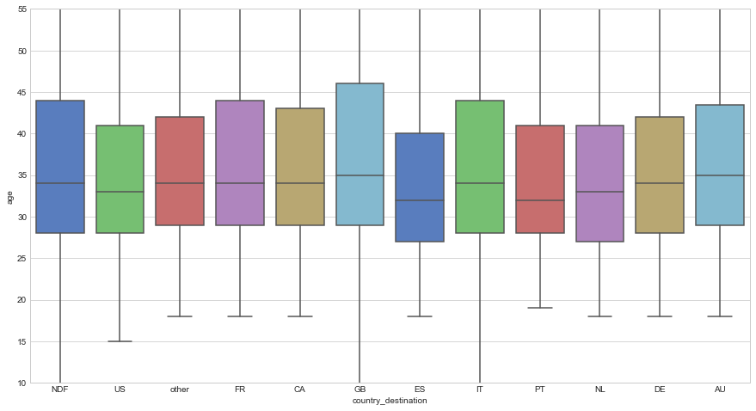
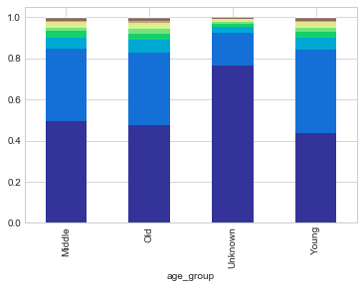
Age

Slide 12
Age Insights
Great Britain has the highest average age of travellers.
Spain is more popular amongst younger travellers.
People who have not disclosed their ages are least likely to book an Airbnb.
Out of the users whose age we know, Middle Aged People are most likely to book an Airbnb although it must be noted that there isn't a very significant difference amongst the three groups.

Slide 13
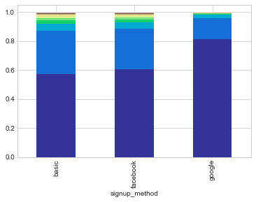
Signup Method
Basic and Facebook are the most popular methods of Signup.
People who use the Basic Method are the most likely to book an Airbnb.
People signing up using Google are the least.

Slide 14
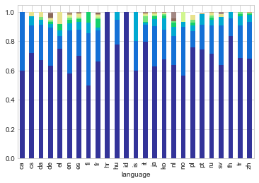
Languages
We see that people who speak Croatian and Indonesian made almost no bookings.
People who spoke Finnish made the most bookings amongst all languages.
The large number of languages is also surprising considering that Americans usually converse and interact with their apps primarily in English.

Slide 15
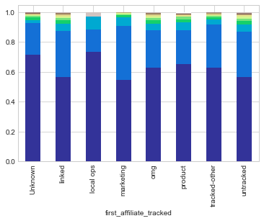
Affiliate Channels
The Direct Channel has the most number of conversions to bookings whereas the Content Channel has the least.
Direct and Google are the most popular affiliate providers.
Wayn has the least percentage of conversions whereas Daum has the most.
Apart from the above, Google and Craigslist have a good percentage of conversions.
People with Marketing affiliates were most likely to book. People whose first affiliate was tracked as Local Ops or was Unknown were least likely.

Slide 16
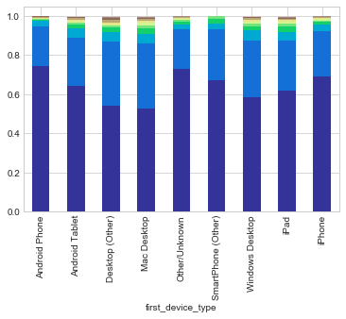
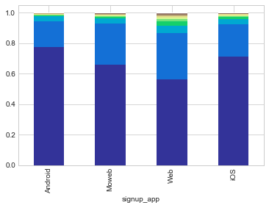
Devices
Users using the Web App are most likely to book an Airbnb whereas Android Users are least likely to do so.
People with an Android Phone or whose devices were unknown bought fewer Airbnbs. People on Desktops (Mac or otherwise) bought more.
This strongly suggests that users on their desktop will be more likely to book an Airbnb and Apple Users are more prone to buying on the website whereas Android Users are the least.

Slide 17
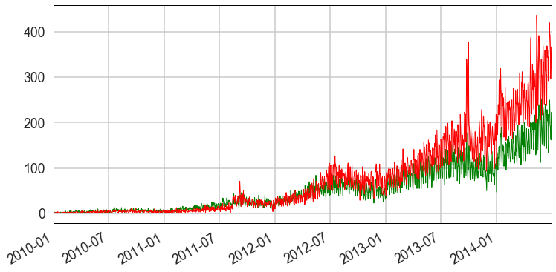
Trends of users booking Airbnbs

Slide 18
Feature Engineering and ML

Slide 19
Session Data
The following features were constructed from the session data:
Number of Sessions: The total number of sessions registered by the user.
Number of types of Sessions: The distinct types of activities logged by a particular user.
Total Seconds: The total amount of time spent by the user on Airbnb
Average Seconds: The average amount of time spent in each session by the user.
Short Sessions: The number of sessions which were less than 5 minutes long.
Long Sessions: The number of sessions which were more than 2000 seconds (or 33 minutes and 20 seconds) long.
Number of Devices: The number of devices used by the user to use the website.

Slide 20
Training Data
The Training dataset contained the bulk of the feature engineering performed to come up with the final training dataset.
All the date features were removed as they were not of too much use to us considering that the test dataset begins somewhere during mid 2014. So all our analysis regarding users dating back to 2010 is moot.
From the insights gained in the exploratory data analysis section, the number of categories were reduced for each variable in such a way so as to increase disparity.
Continuous variables such as age were binned into groups.
Finally, one hot encoding was performed on these categorical variables to arrive at the final training dataset.

Slide 21
Model Choice
3 Models were tested for their accuracy: Logistic Regression, Random Forest Classifier and Gradient Boosting Classifier.
The Gradient Boosting classifier had the highest accuracy of close to 65% whereas Logistic Regression performed the worst with an accuracy less than 60%.

Slide 22
Hyperparameter Tuning
The Gradient Boosting Classifier was tuned for the following parameters:
Feature | Range | Best Value
n_estimators | 100,200 | 200
max_depth | 3,5 | 3
max_features | auto, log2 | auto

Slide 23
Testing and Final Score
The tuned classifier was used to predict outcomes on the test dataset.
The submission dataframe was constructed with the top 5 destinations for each users based on the value of their prediction probabilities.
This dataset was uploaded to Kaggle and the score achieved was 0.86527.

Slide 24
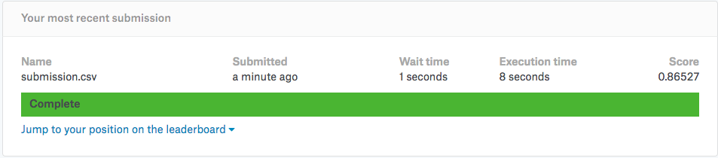

Slide 25
Business Recommendations
The majority of Airbnb's users are on Apple Devices. Additionally, Android users are the minority and don't book that often. It makes perfect business sense to invest more resources in improving the user experience of iOS apps. On the other hand, Airbnb could also investigate into the smaller conversion rate of Android Users and try to deduce some correlation with certain quirks of the Android Airbnb App.
Desktop Users book far more often than other device users. This could mean that people use smaller devices for surfing and exploration and desktops to make the actual booking. The User Experience for the apps on different devices must be tuned accordingly to achieve best results.

Slide 26
Business Recommendations II
Most of the Airbnb Users tend to book an Airbnb within the country. Therefore, it makes most sense to give the users more recommendations that are endemic to the country. American users should get more Experience and Host recommendations within the USA. This is not the case with the current Airbnb site where most recommendations are that of exotic locations in faraway places.
People who haven't filled out their information such as Age and Gender are the least likely to book Airbnbs. This is likely due to the fact that they are only in the exploration stage. Maximum marketing effort must be aimed at these people and the most enticing yet affordable offers must be made to them to increase their rate of conversion.

Slide 27
Conclusions
To summarize the following steps were performed to arrive at the final result:
Data Wrangling
Inferential Statistics
Exploratory Data Analysis
Feature Engineering
Machine Learning
Business Recommendations
A system was obtained with a NDCG (Normalized Discounted Cumulative Gain) of 0.86527 on the first submission to Kaggle.

